Slide 1







Optimal Electric vehicle Charging Stations Installation
Team Name:
Ministry : Housing and Urban Affairs
PS Code : BV806
Theme : Smart Vehicles
Institution : Vasavi College of Engineering
Institute Code (AISHE) : C-26162

Slide 2
Problem Statement
EV Charging stations location problem needs to be solved.
Targeted usage areas are cities with population > 4 million
Core of the problem is optimal striking the balance between Demand and Supply
A solution proposal to help cities locate EV(Electric Vehicles) charging infrastructure
Location analysis of charging infrastructure that aids the EV roll out plan by government ministries.

Slide 3
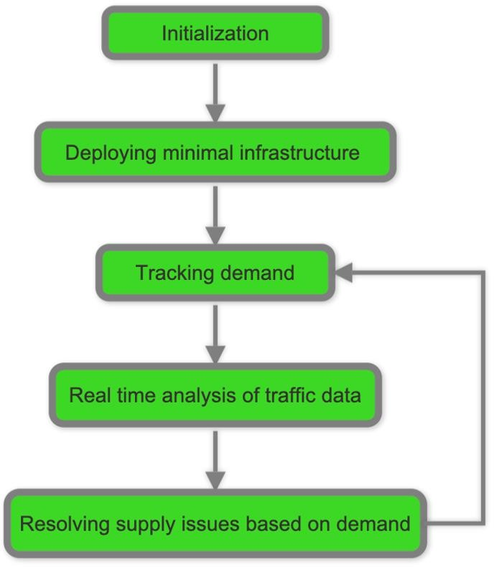
Idea/Approach Details
Solution is divided into 5 equally important steps.
Initialization
City is divided into grids of equal size.
Routes are defined on the map using shapefiles.
Data required (like population, availability of lands, vehicle data, etc..) is procured from government and other sources.
Initializing the database.
Deploying Minimal Infrastructure
Locating existing EV charge stations and adding them to database.
Deploying new EV charge stations in areas where there are no charge stations using an algorithm that suggests best locations considering inputs like population, road traffic, etc.
Tracking Demand
Every time a vehicle charges at a station, details of charge are added to database in the
following format:
{Station ID, Transaction ID, Vehicle number, Charge time, Energy charged, Bill details}
Real-time Analysis of vehicle data
Based on the transaction details, the demand factors at Station level and Grid level are updated in the database.
Notifying admins at different levels if there’s a need for deploying new infrastructure.
Resolving the supply issue
When demand reaches a certain value, areas with high demand are selected for deploying new stations.
A new station needs to be installed at a location that is in the area of the existing station where the demand is high.
Optimal locations for installing new station are suggested by the software.
Admins can discuss and choose among the suggested places after approvals.
Public use of this data(Future Scope)
This database can be used to create an app for common people to know the availability of
charging ports around them and schedule their charge time.
Technology Stack:
QGIS Software (Quantum Geographic Information System) for location analysis and graphical representation.
MySQL DBMS for storing and managing Database
Python scripting or backend maintenance
Flutter and Angular for Frontend

Slide 4
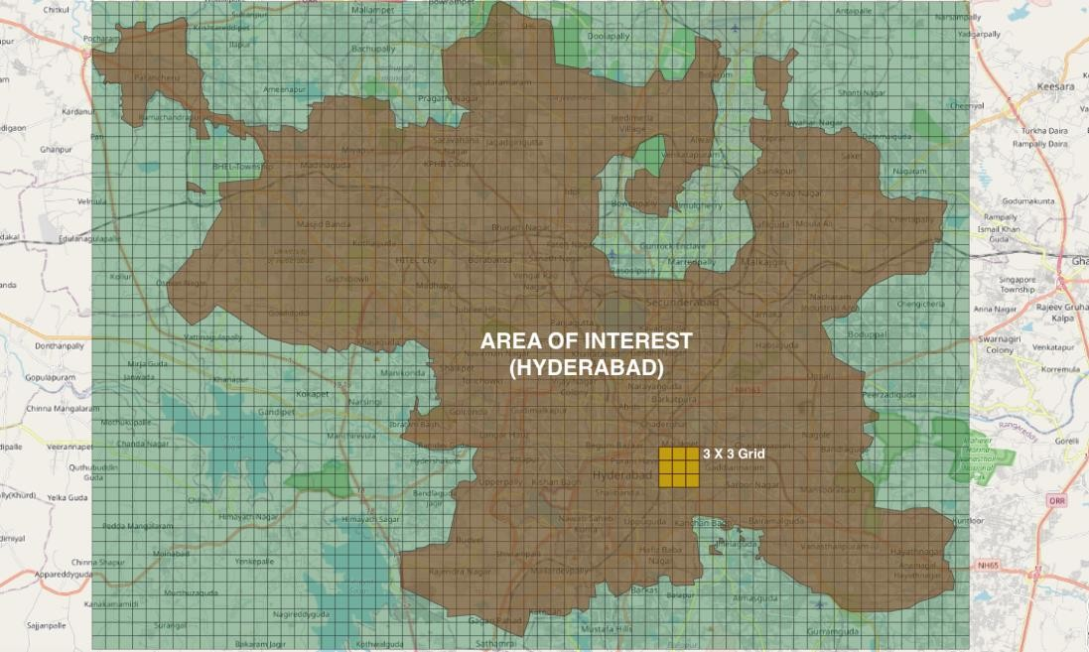
Idea/Approach Details
Show Stoppers:
Grid analysis using QGIS software has a high precision and
gives accurate results.
Every result or extracted information is returned both graphically and in a tabular manner.
Real-time analysis of demand makes the decision-making simpler.
Well defined user-friendly UIs for all types of users, so that they can use this software without much knowledge on programming
Centralized database of all the stations helps in optimal usage of resources and sharing between stations.
Use Cases:
User Type: Admin( Government authorised official):
Can define the precision of analysis.
(This defines the dimensions of grids by which map is divided. )
Can view the real-time traffic and energy usage insights at a Station/ Area / Grid / Route.
Can view the priority order of need for resolution of supply issues.
Will be notified when the demand reaches a threshold value.
Can see the location suggestions for installing new charge stations.
Can add a new entry to the database whenever a new station is installed.
User Type: Station Admin (Authorised personal of charge station)
Can view the traffic insights of a particular station.
(Usage and occupancy statistics of each slot in that station)
Can view the energy insights of the station.
Will get notified when daily demand at that station reaches a
threshold value and there’s a need for new ports to be installed.
(Future Scope)
User Type: Vehicle Owner (Common people):
Can view the availability of slots at a selected station.
Will be able to schedule a charge at any station in his/her way.

Slide 5
Team Members
Add a group photograph of all team members
Then add details of team members

